Slide 1
PBA NEWS LETTER MAY 2022
FROM THE DESK OF EDITOR :
Prior to freedom of India Dr B.R Ambedkar struggled a lot for the rights of depressed classes. He was of the firm vies that it is education by which this society may become literate, fight for their rights and get themselves organized . Educate, Agitate, Organize is his remarkable slogan which lighten us and show a path for today’s and future struggle to obtain real freedom to live, to educate, to get our share in national assets and economy. In 1926 in Bombay legislative assembly he advocated need and methods to educate depressed classes. The motive of education should be to produce humanity, equality and fraternity apart from character building for the Citizen of any country. He was not only a jurist, socialist, politician, social scientist, constitionalist but also a pedagogist whose works are not yet been correctly evaluated and paid attention by the governments even after independence.
He suggested simple formula to the government to spend as much amount on education as the collection of excise duty from the people apart from non-commercialization of education in India.
ER SUNDER PAL SINGH

Slide 2
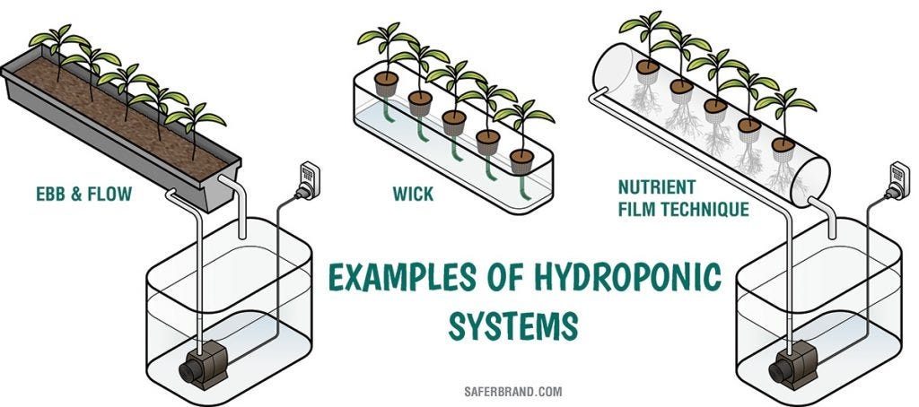
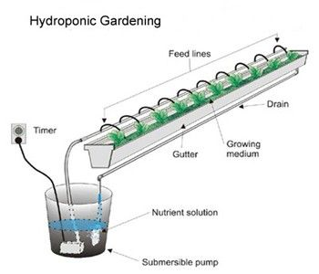
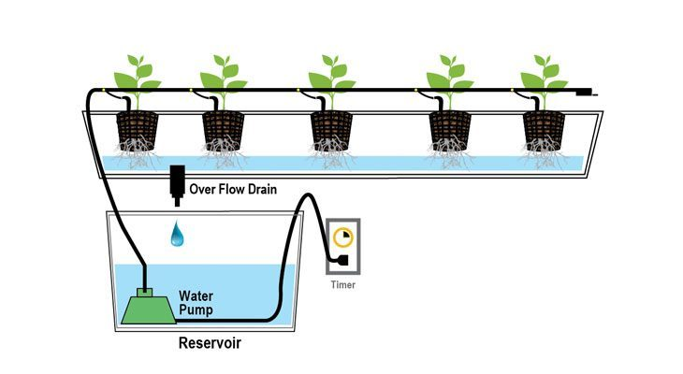
HYDROPONICS 03-05-2022
Hydroponics: A method of growing plants in water without soil. Types are- Deep Water Culture – System completely submerses your plant roots in a highly oxygenated nutrient water solution and promotes fast growth. Drip – Drip systems deliver nutrient water solution slowly into the plant medium. It ensures the medium stays moist while growing. Ebb and Flow – In a ebb and flow system plants grow in water-absorbing rock wool, periodically flooded with water. Nutrient Flow Technique (NFT)–Most commercial system where circulate a light film of water around the plant’s roots, with no growing media. Reservoir– Easiest system to maintain, a plant container, which holds your growing media and the plant itself, is partially submerged in a reservoir tank filled with a nutrient solution that’s circulated with a small pump. Wick– A simple system, the wick operates much like the reservoir system except a knotted nylon rope draws water up to your plant container. By Dr M.C Singh Principal Scientist

Slide 3
Aeroponics 03-05-2022 By Kishan Singh Jame
 | Aeroponics is the process of growing plants in an air or mist environment without the use of soil or an aggregate medium. The word "aeroponic" is derived from the Greek meanings of aer and ponos. Aeroponic culture differs from both conventional hydroponics, aquaponics, and in-vitro (plant tissue culture) growing. Unlike hydroponics, which uses a liquid nutrient solution as a growing medium and essential minerals to sustain plant growth, or aquaponics, which uses water and fish waste, aeroponics is conducted without a growing medium. It is sometimes considered a type of hydroponics, since water is used in aeroponics to transmit nutrients.

Slide 4
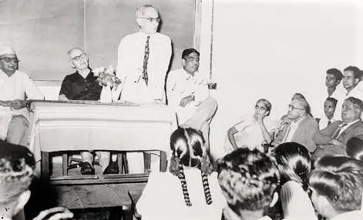
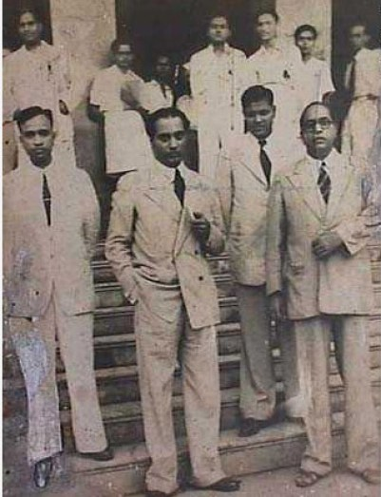
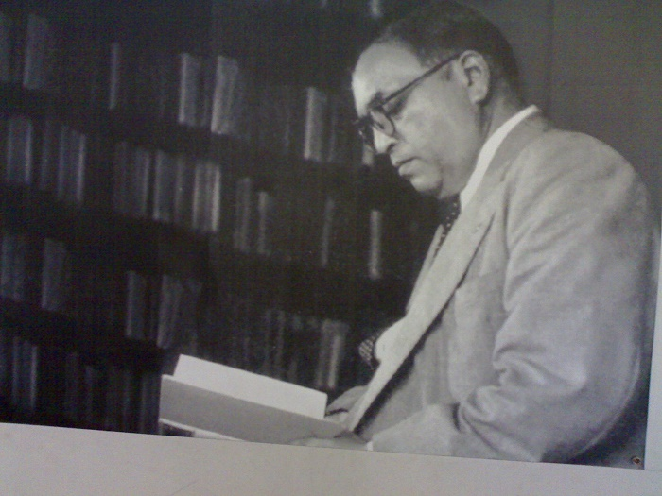
Education policy for unprivileged Society- Ambedkar’s View By Er. Sunder Pal Singh 08-05-2022
DR. AMBEDKAR – THE SUPERHEROES WHO PAVED THE WAY FOR EDUCATION AND EMPLOYMENT FOR DALITS If we were to choose from the whole of Indian history a man who paved the way for education and employment for Dalits, made them aware of their rights, freed them from the exploitation of other communities, proved their superiority in the field of intelligence as well - Ambedkar alone will be found with all these characteristics. He did not think about education in an educational manner like Gandhi or Dayanand Sarasvati or Vivekananda, but wherever he got the opportunity, he made his clear talk about education and in the process, his concerns about the education of the Dalit community also came to the fore. He wrote: “If the government wants to spread education among the Dalit castes with a sincere heart, there are some measures that the government must take- “Until the compulsory education act is repealed and the transfer of primary education to the school boards is stopped, there is an apprehension that the interest of the depressed classes will continue to suffer a severe blow. Unless the essentiality of primary education is made mandatory and unless the rule of admission to primary schools is strictly followed, the necessary conditions for the educational progress of the backward castes will not arise. Unless the recommendations made by the Hunter Commission on the education of Muslims are also applied to the educational progress of the Dalit castes, their progress will remain incomplete. Unless the Dalit castes are taken into government jobs, their affection for education will not increase. | Dr Ambedkar at Siddhartha College Ambedkar with Homi Bhabha and other colleagues at Siddhartha College

Slide 5
Buddha in business Management 15-05-2022 By Er Sunder Pal Singh
What is Buddhism? Buddhism is a religion based on the teachings of Siddhartha Gautama. He came to be called "the Buddha" which means "awakened one”, after he experienced a profound realization of the nature of life, death and existence. In English, the Buddha was said to be enlightened, although in Pali it is bodhi, "awakened." What is Management ? Management is the administration of an organization or a governing body. It is the art and science ( Skill & Intelligence) of managing resources 10 Ms (Men, Materials, Machines, Minutes , Money, Methods, Measurement, Marketing, Motivation & Maintenance) of the business. The Noble Eightfold Path : 1. Wisdom (Right View, Right Intension) 2. Ethical conduct (Right Speech, Right Action, Right Livelihood) 3. Mental discipline (Right Effort, Right Mindfulness, Right Concentration). These eight aspects of the path are not to be understood as a sequence of single steps, instead they are highly interdependent principles that have to be seen in relationship with each other and are being used in ethical business not only in Buddhist countries but in India too. | The Buddhist Framework : There is : Pain • Origin or source of pain • How to put an end to pain; and • How to embrace a path where pain can be avoided. Mission: Buddhism didn’t just extol that pain is par for course for humanity. It also charted a blueprint for overcoming pain constructively and turning it into gain, which in management terms is called ‘Mission’. It is the to-do list for actualizing your vision. Vision: Let’s look at the vision first. What is vision ? Again in layman terms, vision is the organization’s way of articulating why we do what we do. In other words, what is the pain we see in the life of our customers, and how we want to alleviate that pain with our product. Objectives: With the help of eight noble path we should set our objectives to achieve our mission and vision.

Slide 6
THE PERSONALITY DEVELOPMENT 22-05-2022 BY MISS JAY SHREE
What is Personality Development ? Personality means true nature of a person. Personality Development is important because it focuses on developing human skills such as, developing communication skills, confidence building, learning ethics, morals and values, gathering better emotional intelligence, conflict resolutions, enhancing thinking acumen, leadership skills, so on and so forth. Personality development is very important in personal as well as in professional life. Key to Success: 1. Knowledge 2. Skill and 3. Attitude Most Important Skills: Effective Communication Skills Corporate Grooming and Etiquette Good Interpersonal Skills and Teamwork Good Presentation Skills Problem Solving / Design Thinking Email / WhatsApp Etiquette English Language Skills Creativity

Slide 7
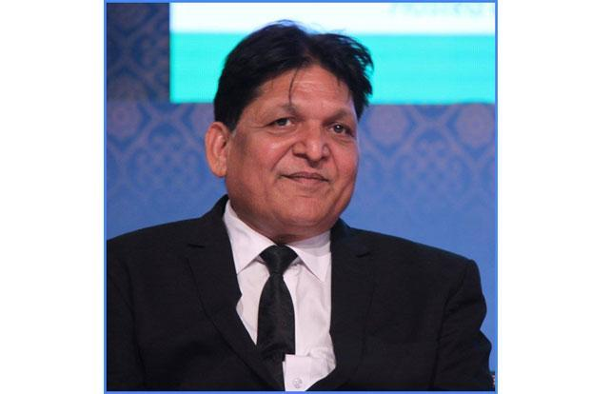
The SUCCESS STORY OF ENTREPRENUERS 29-05-2022
Shri R. K Singh an entrepreneurs and national president of DICCI North. He told the participants about his success story as a business man. After Diploma in Electrical Engineering he though having numbers of appointment letters for various government jobs but preferred to go for business. He is Chairman Managing Director of M/s Marshal Enterprises Bulandshahar U.P and deals in manufacturing Grid Sub Stations & Solar Energy Production. He insisted for every one in family to have their separate ITR(Income Tax Return). He advocated for joint ventures to be eligible for participating in larger tenders of State/ Central Governments. He also advised PBA members to enter into business. He assured to extend his help for needy for obtaining license, guidance in export/import or in any other fields. He also thanked PBA to have such platform to motivate and facilitate our aspirants to enter into the business. | Dr Chandrabhan Prasad He elaborated the need for entering into business. He advocated for the need of Dalit Economy. 4. When asked for branding he told that though the branding by Dalit names is not yet proved successful in all the fields but found success in music's bands specially in Punjab. Though the use of Dalit was objected but still it was insisted that today or tomorrow we have to raise platform of our separate economy by entering into manufacturing, trading, servicing, media, Judiciary, active politics and so on.
 |  | 5. He also supported views of Shri R K Singh and advocated to increase ITR of depressed classes to participate in larger economy
 | PROGRESSIVE BUSINESS ALLIANCE, H.Q AT MEERUT

