Slide 1
PROGRESSIVE BUSINESS ALLIANCE
Helps to
achieve your dreams

Slide 2
Introduction
The business in India has it’s root in capitalism. Since the ancient period in India business has been played like a ball in the hands of the Rulers and the Capitalists. The Capitalists and the Rulers for oppressing general public mainly labour class. There left minimum opportunities for the under-preiveledged society to enter into business class.
The manufacturing, trading, stocking, distribution, marketing, different industries like film, media, print as well as electronic, telephone or mobile, business sales, medicines, mediators, contactors etc are the game of nexus between the rulers and the capitalists. In democracy the capitalists donate huge funds to both ruling as well as opposition parties resulting opperession of the general public mainly downtrodden society of India.

Slide 3
Continue-------
The micro, small, medium and large industries including cottage industries, education, health, banking plays in the hands of of the administrators and ministers, Tough after liberization of industrial policy few from the labour community have risen to come as entrepreneurs but limited in few numbers. The top capitalists in India have expanded their hands to manufacture and trade daily needs of human beings as well as of animals. Nothing major left out for others. But as the government policy for MSME many new entrepreneurs are being developed and they are doing well.
Our mission is to develop and motivate such new entrepreneurs of under preiveledged society to come forward to become employer rather being employees.
Progressive Business Alliance will help them in fulfilling and achieving their dreams as non-political, non-religious, non-registered organization based on no profit no loss principles. PBA will guide, assist, co-operate and make them to communicate with each other to make our country PRABUDDH BHARAT / SAMRADDH BHARAT.

Slide 4
DEFINITION:
PROGRESSIVE BUSINESS ALLIANCE IS AN AUTONOMOUS ASSOCIATION OF JOINTLY OWNED AND DEMOCRATICALLY CONTROLLED PROFESSIONALS/ENGINEERS/DOCTORS/BANKERS AND ENTERPRENUERS UNITED VOLUNTARILY TO MEET THE SOCIAL, ECONOMIC AND CULTURAL NEEDS AND ASPIRATIONS OF THEIR UNDERPREVILEDGED SOCIETY .

Slide 5
OUR MISSON
Social and Economic Transformation of the under privileged society.

Slide 6
OUR AIM
To fulfil the dreams of Under Privileged Entrepreneurs.

Slide 7
OUR GOAL
To create an Alliance of minimum 100 Entrepreneurs within one year and develop new Entrepreneurs.
To create new business society among downtrodden.
To develop inter-communications among these small, medium and large entrepreneurs.

Slide 8
OBJECTIVES
a) To help and assist for Startup India and fulfill dreams to become self–independent to make ‘Prabuddha & Samraddha Bharat’, also to assist in implementing Schemes / policies of Govt. of India.
b) To promote and protect Trade &, commerce among all members, industry, Import / export, professionals, educationists, collect & circulate the statistics and other related information for creating new customer / clients and rating agency.
c) To Initiate and Assist activities for Thinking Skill, Educating and Improving Social and Economic status of under privileged Indian society.
d) To provide on line information, awareness, R & D, human resource, employment, growth & stability and related industry and labor laws.
e) To provide financial assistance for State / Central Govt., NGOs, banks and other legal entities or individual as per law of land.

Slide 9

OUR LOGO

Slide 10
MEMBERSHIP - FORM
The Chief Convener / Convener,
Progressive Business Alliance PHOTO
766/8, Jagriti Vihar, Meerut.
I hereby apply for the Membership of Progressive Business Alliance.
1. Name of the Company / Organization/ Professional: _____________________________________
2. Office /Works Address: ____________________________________________________________________
3. Contact Details: Mobile No. : ............................ Phone No. : ..........................
E-mail: .................................... Website:...............................
4. Nature of Business: (√) mark the following business to which you belong.
( ) Manufacturing ( ) Services ( ) Food ( ) Trading ( ) Textile ( ) Leather ( ) Other
5. Legal Status: (√) mark the following to which you belong.
( ) Private Ltd. ( ) Partnership ( ) Proprietary
6. Type of Industry: (√) mark the following to which you belong.
( ) Large ( ) Medium ( ) Small
7. Establishment date of Company / Firm:
8. No. of Employees:
9. Last Two Years Turnover:
10. Certification (s) if any (like ISO):
11. Product Details:
12. Category: (√) mark the following to which you belong.
( ) SC ( ) ST ( ) OBC ( ) Other
13. Enrolment Fee (One Time Only) : Entrance Fee for different categories is as follows :
Member: Large enterprise: More than Rs.one crore: Rs.10,000/=
Small enterprise: More than Rs. 25 lacs but does not exceed Rs. 1 crore: Rs. 5,000/=
Tiny enterprise Start up Member / Professional: Up to Rs. 25 lakh : Rs. 2500/=
15. Monthly Subscription: Subscription is Rs 1000/= per Month from all members.
16. Mode of payment: Cash / Cheque or DD in Favor of ‘ Progressive Business Alliance’ payable at MEERUT.
Principal Adviser: Name
Chief Convener: Signature (With Company Seal)

Slide 11
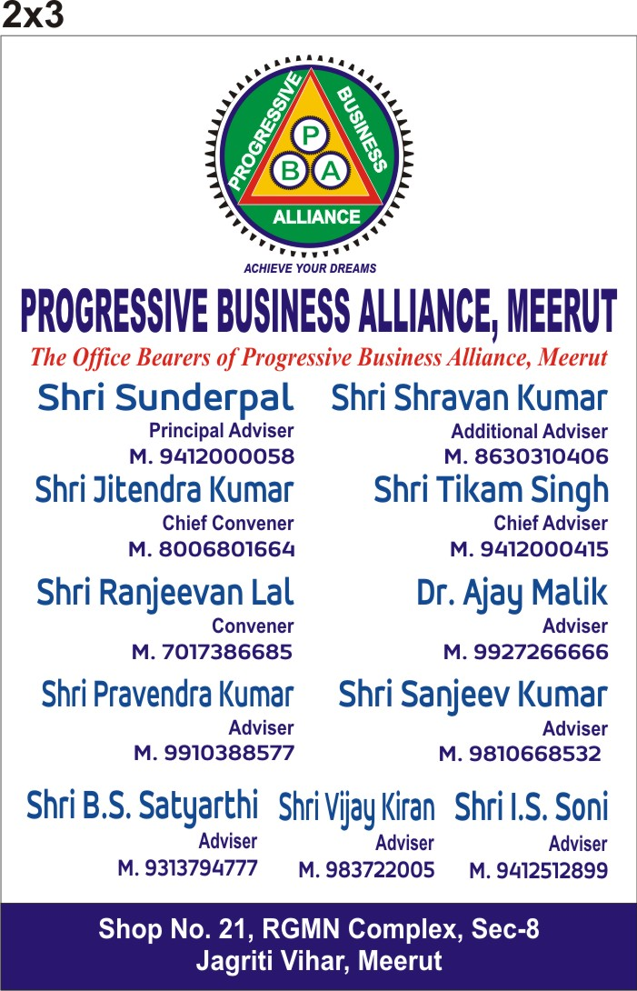
THE CORE GROUP MEMBERS

Slide 12
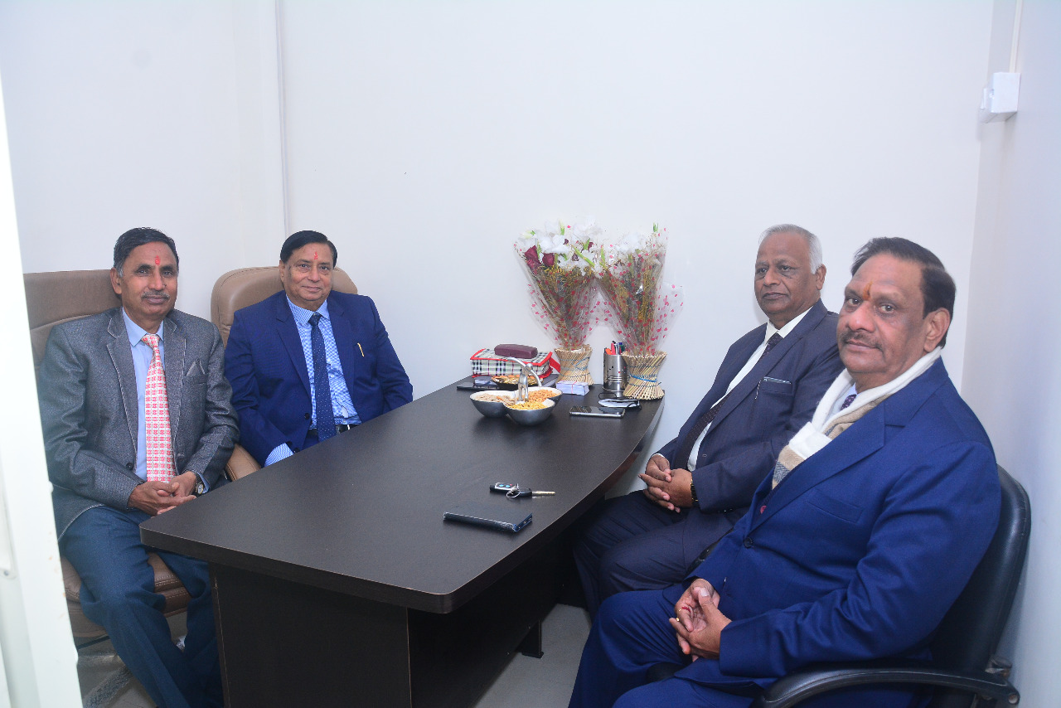

Slide 13
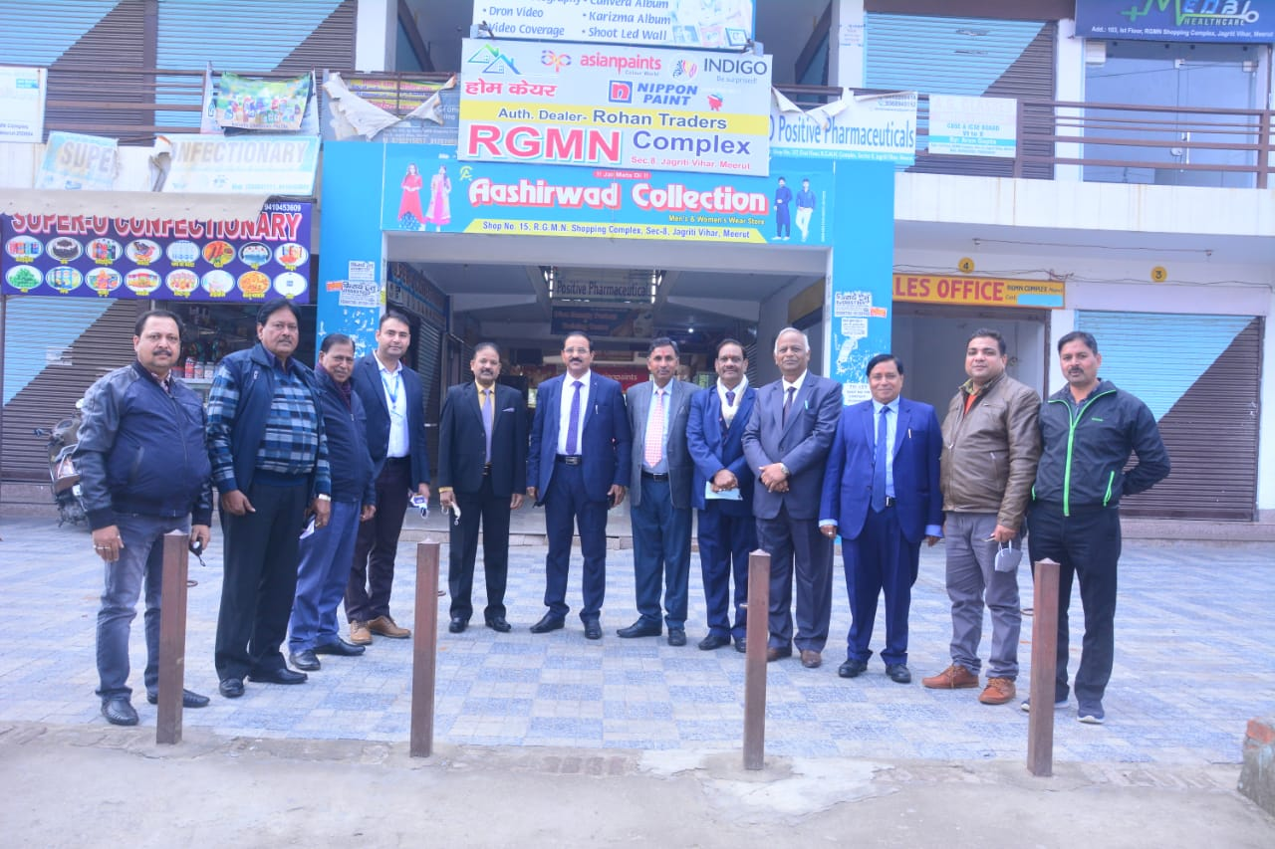

Slide 14
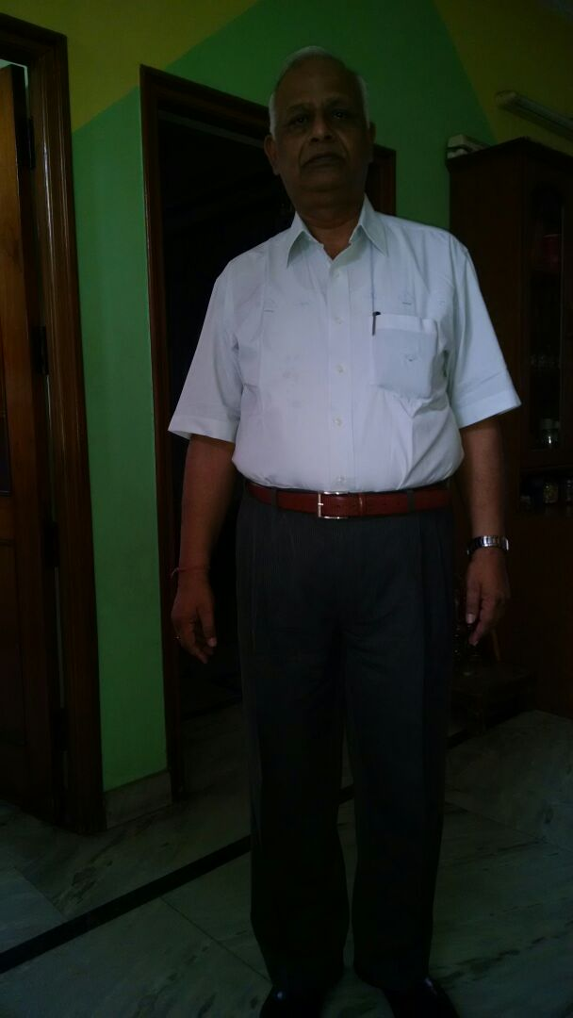
SUNDER PAL SINGH- PRINCIPAL ADVISER
Ex- Chief Engineer, bsnl batchler of engineering and mba (finance)

Slide 15
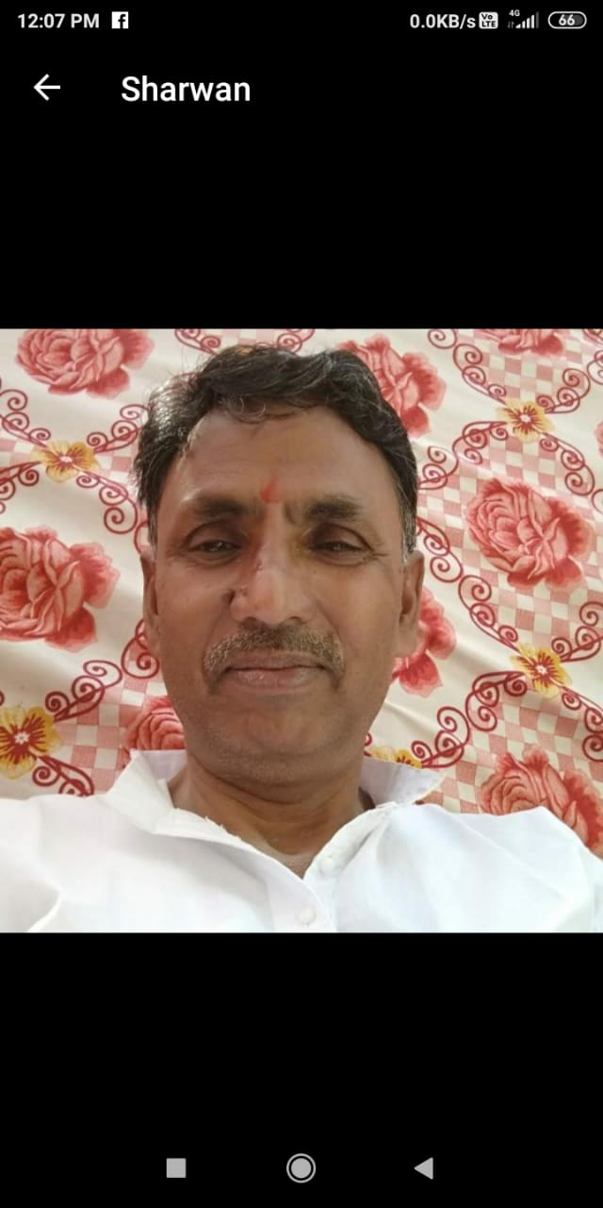
SHARWAN KUMAR – ADDITIONAL ADVISER
Ex- Chief manager allahabad bank

Slide 16
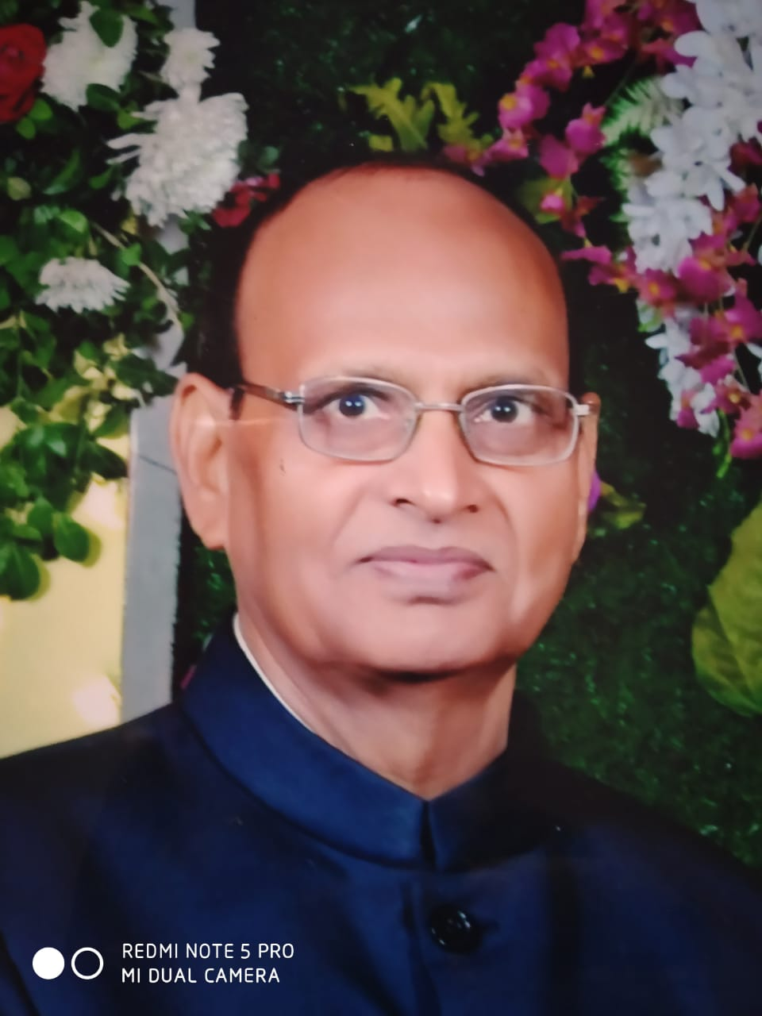
Tikam Singh- ADditional Adviser
Ex- General manager bsnl b. sc , b. tech

Slide 17
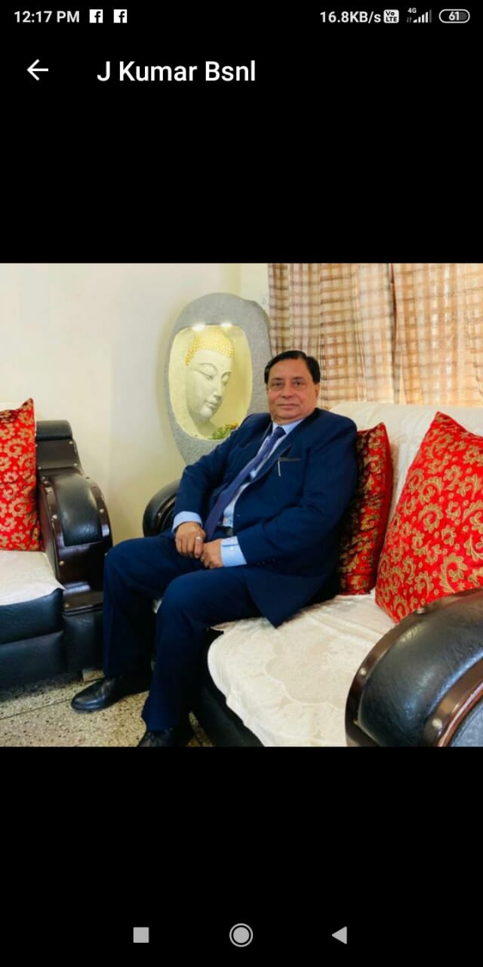
JITENDRA KUMAR- CHIEF CONVENER ex- chief manager Allahabad bank b. sc

Slide 18

DR AJAY MALIK- ADVISER

Slide 19
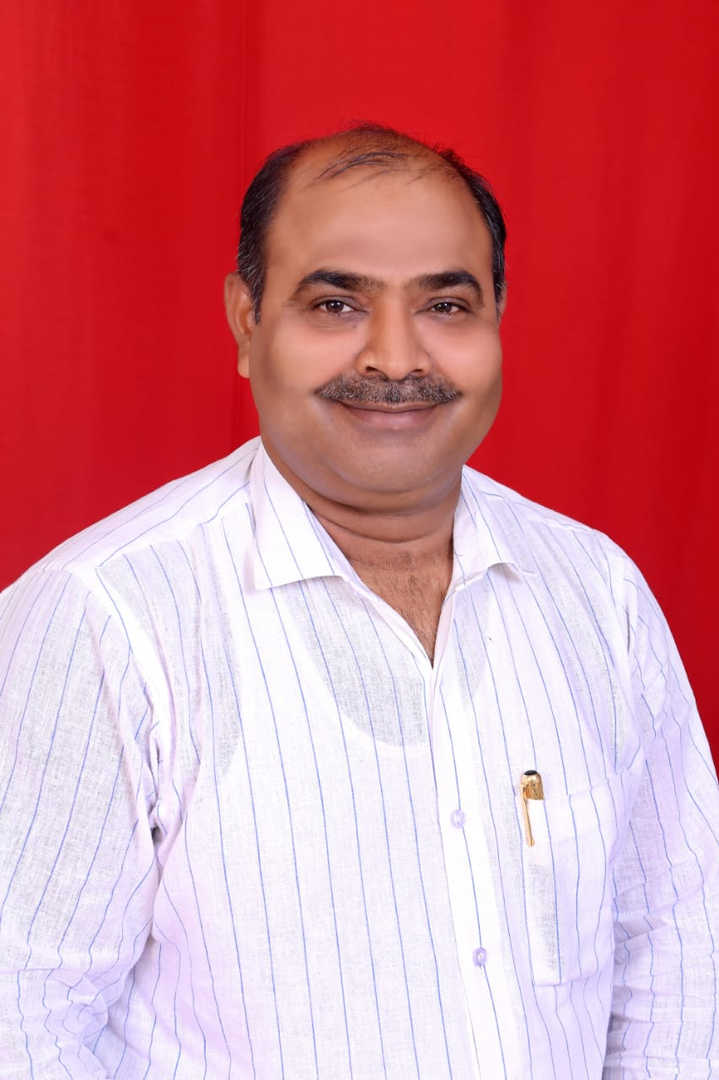
Ramjeevan lal- co-ordinater

Slide 20

ER DHARAM PRAKASH- ADVISER

Slide 21
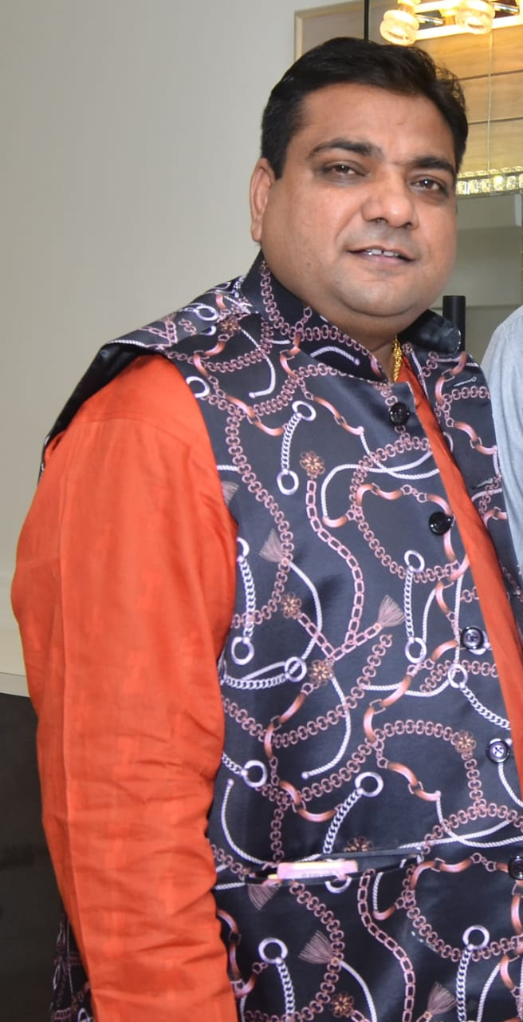
SANJEEV KUMAR- ADVISER

Slide 22
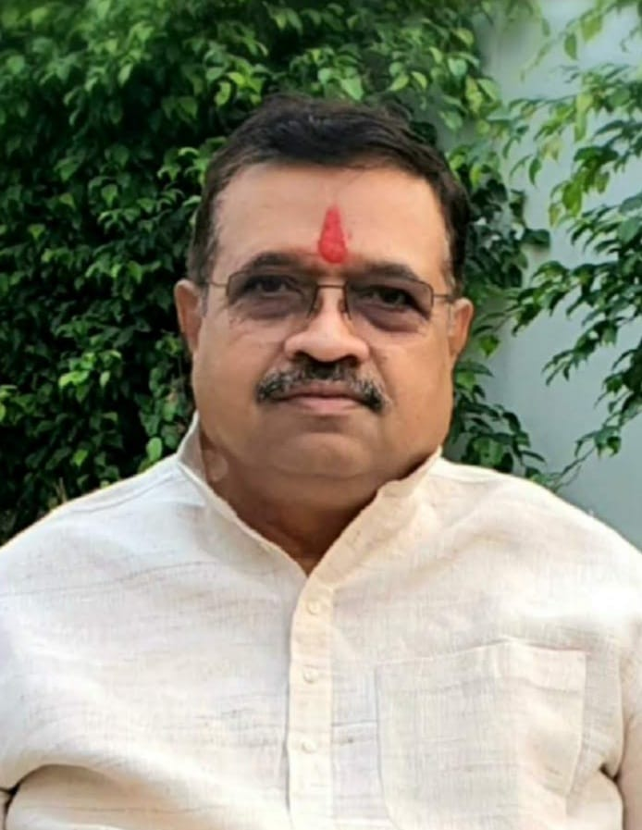
Pravendra kumar - Adviser

Slide 23
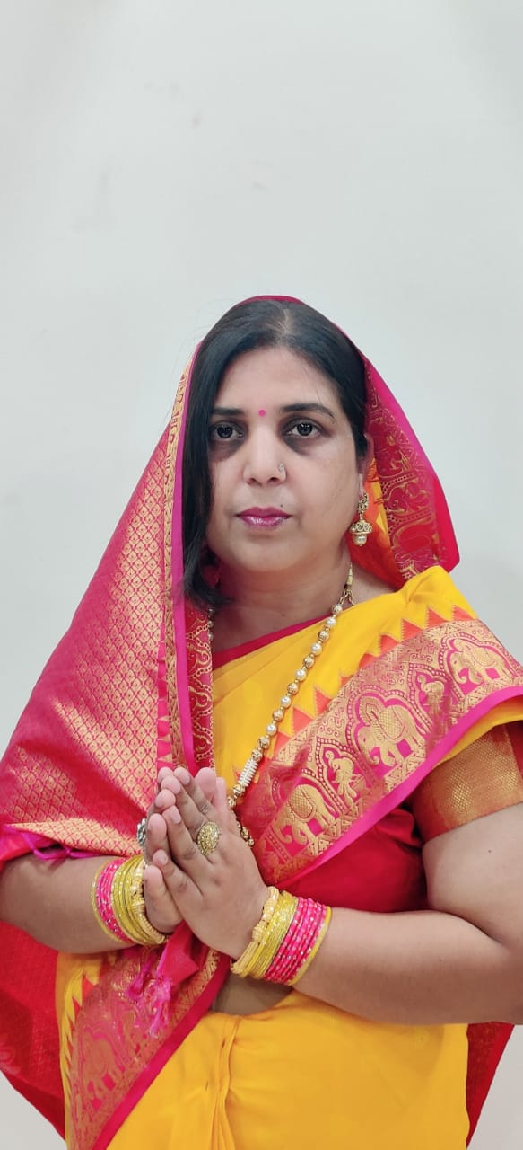
MRS ANURADHA- ADVISER

Slide 24
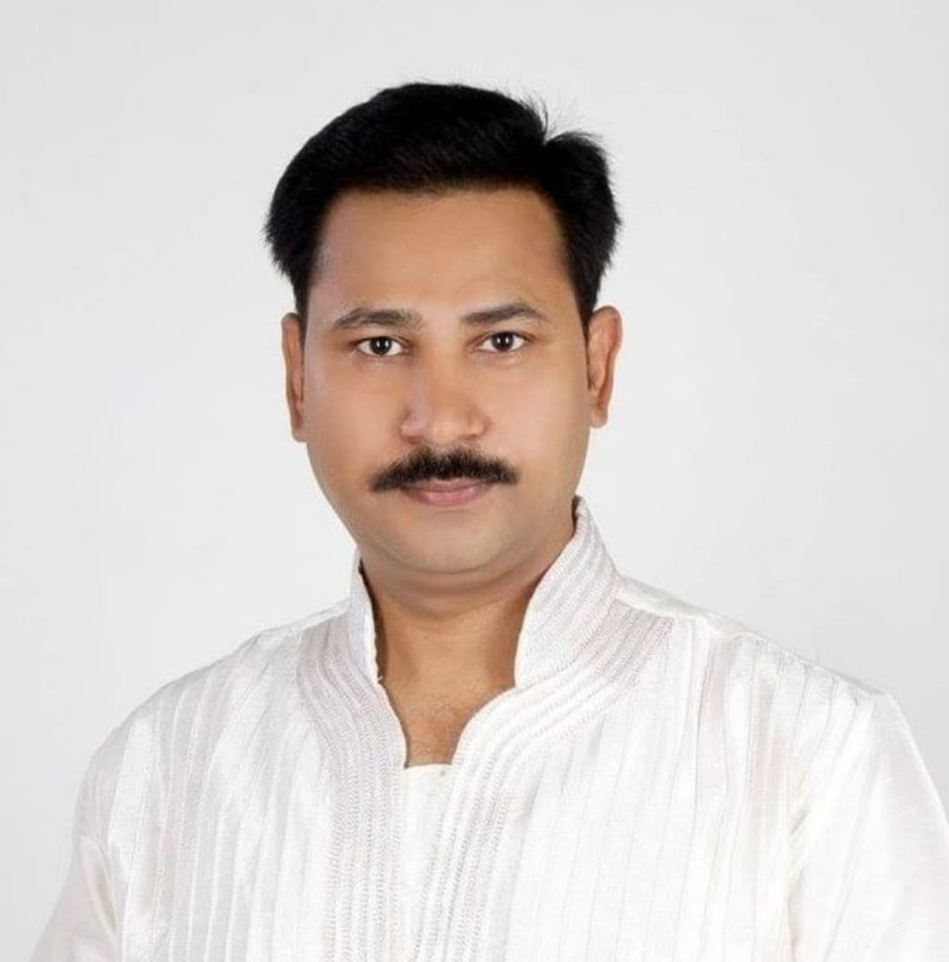
Amit vir singh- adviser

